Slide 1
Literary Devices Recap

Slide 2
Connector
How many literary devices can you think of?

Slide 3
LO – All will learn what literary devices are Most will learn why a writer uses them Some will be able to use them for effect in their own writing

Slide 4
Big Picture
You will always need to know these in English, even if you choose to study it at University!

Slide 5
Key Words – copy these, and leave a space of about three lines in between each one!
Simile
Metaphor
Personification
Alliteration
Repetition
List of three / tripling
Onomatopoeia
Oxymoron

Slide 6
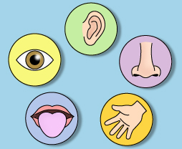
Simile
When you use like or as to compare something.
Examples
As tough as old leather
As blue as the sea
It felt like I had dropped a ten tonne weight on my little toe!

Slide 7
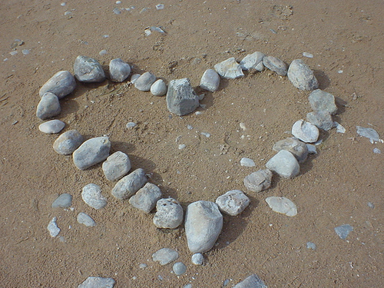
Metaphor
This is when you say something is something else.
Examples
She has a heart of stone
Juliet is the sun
I’m boiling

Slide 8
Personification
This is when you give something a human quality, when it’s not human.
Examples
The sun smiled down on the people
The computer hates me
She could tell that the wind was angry

Slide 9
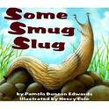
Alliteration
This is when the same sound is repeated in a phrase.
Examples
Creepy crawlies
Slimy slithering snake
Breaking ebb of the beautiful ocean

Slide 10
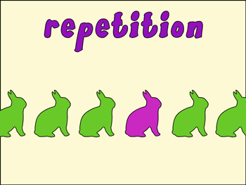
Repetition
When a word is repeated more than once deliberately.
Examples
When we are put in the LRC we are bored, bored, bored!
You can try harder, you can do more revision, you can easily make it to a level 5.

Slide 11
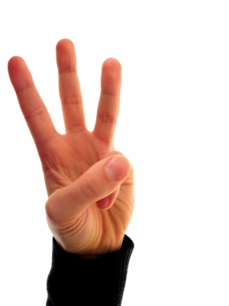
List of three
Sometimes called ‘tripling’
When a list of three things is used.
Examples
A Mars a day helps you work, rest and play.
I feel tired, lonely and depressed.
The room was dark, the door squeaked open and the mysterious man entered.

Slide 12
Onomatopoeia
When the words sound like what they are describing.
Examples
Zoom or bang.
The cow mooed.
The door slammed shut.

Slide 13
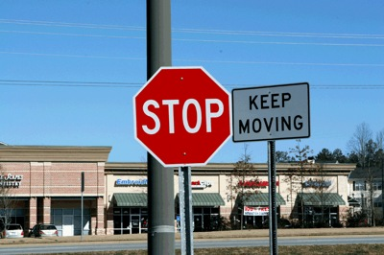
Oxymoron
When two opposites are put right next to eachother.
Examples
Smart casual.
This dark chocolate is bittersweet.
In a state of melancholy madness.

Slide 14
Literary devices
Often, texts are full of these. You should try to use them in your own writing as they create effects for the reader, a level 6 skill!
If you spot them in your analysis, and analyse the effect they have on the reader, this is also a level 6 reading skill.

Slide 15
Task
Fill in the table.
Focus on the effect on the reader, and why the writer would include this.
Remember you are the reader, so however this effects you is correct!

Slide 16
Task 2
I U?
Write a sentence with an example of each of the literary devices you have learned today.
Make sure they work – I could say that ‘Love is a red phone box’ is a metaphor, but it doesn’t work really because there are no links between love and phoneboxes!

Slide 17
Review
What is this example and how does it effect the reader?
Smash! The milk was all over the floor.
The boy was scared.
We have a love hate relationship!
The grandfather clock stood proudly in the hallway.
The creepy old codger was sneaky, weird and sinister…
The bumble bees buzzed around.
I don’t like her, I don’t like her ideas and I certainly don’t like her attitude!
The tap was dripping.
The trees whispered as she ran through the forest.
She looked as if she was dead.
He looked like my Uncle Vinny!

